Slide 1
DataSpark - Illuminating Insights for Global Electronics
Capstone Project – 2
By
Arangarajan Vinayagam

Slide 2

Objective
The main aim of this project is to identify critical insights that will enhance marketing strategies, optimize inventory management, and improve sales forecasting by examining Global Electronics' customer, product, sales, and store data.
This will assist in deciding on shop expansions and optimizations, creating better items, planning successful promotions, and customizing marketing strategies.

Slide 3
Project Overview
Global Electronics, a major consumer electronics retailer, seeks to leverage its data for insights that will enhance customer satisfaction, improve operations, and support business growth. This project involves conducting a comprehensive Exploratory Data Analysis (EDA) across datasets covering customer statistics, product performance, sales metrics, store operations,
In order to achieve this, the strategy involves:
Data Cleaning and Preparation: Locate and manage missing values, transform data types (e.g., dates, numerical values), and integrate datasets as needed to connect sales, product, and customer information.
Data Loading: Load the cleaned and prepared data into a SQL database by creating and populating required tables with SQL INSERT statements.
Power BI Visualization: Use SQL data to create interactive dashboards with visual insights and trends for better decision-making.
SQL Insights Queries: Create and run SQL queries to answer key business questions and assist analysis.

Slide 4
Data Cleaning and Preparation:
Step 1:
Import libraries
Step 2:
Load the dataset ‘Stores’ and read with pandas
Checked missing values and replaced with fillna (‘square meter’ columns = 1 missed value)
Ensures that all values in the ‘Country’ and ‘State’ columns are treated as strings (astype (str)), which can be useful for standardization
Converts 'Open Date’ column values into Date-Time Format (using specified date format: '%m/%d/%Y’)
Step 3:
Load the dataset ‘Exchange Rate’ and read with pandas
Checked missing values (found none)
Converts 'Date’ column values into Date-Time Format (using specified date format: '%m/%d/%Y’)
Step 4:
Load the dataset ‘Products’ and read with pandas
Checked missing values (found none)
For ‘unit cost’ and ‘unit price’ column values, remove dollar $ sign and converted into float type
Remove space and commas if any

Slide 5
Data Cleaning and Preparation:
Step 5:
Load the dataset ‘Customers’ and read with pandas
Checked missing values and replaced with fillna (‘state code’ columns = 10 missed value)
Converts Birthdate’ column values into Date-Time Format (using specified date format: '%m/%d/%Y’)
Step 6:
Load the dataset ‘Sales’ and read with pandas
Checked missing values and found ‘Delivery date’ column values with 49,719 missing values)
Converts ‘Order date’ column values into Date-Time Format (using specified date format: '%m/%d/%Y’)
Dropped ‘delivery Date’ column (which is having more missing values and not much impact on other class values)
Ensured that all values in the ‘currency code’ column are treated as strings (astype (str)),
Step 7:
Ensured that each dataset is cleaned (after checked/removed for duplicate values and any space or commas in each column values)
Merged all cleaned data into a single data frame using Pandas merging function with inner join method for analysis

Slide 6
Create Tables and insert values in Postgresql:
Step 1:
Establish connection between VS code and Postgresql (import psycopg2)
Create tables and insert CSV data values (‘Stores’, ‘Exchange_rate’, ‘customers’, ‘Products’, ‘Sales’, ‘overall’)
Created SQL queries for each dataset to get analysis
Step 2:
Establish connection between Postgresql and Power Bi
Import data from Postgresql into power Bi
Apply formulated SQL queries and do analysis from each dataset to extract key insights
Create interactive dashboard in Power Bi and get results of visualization from the analysis (Customer analysis, Product Analysis, Sales Analysis, and Stores Analysis)

Slide 7
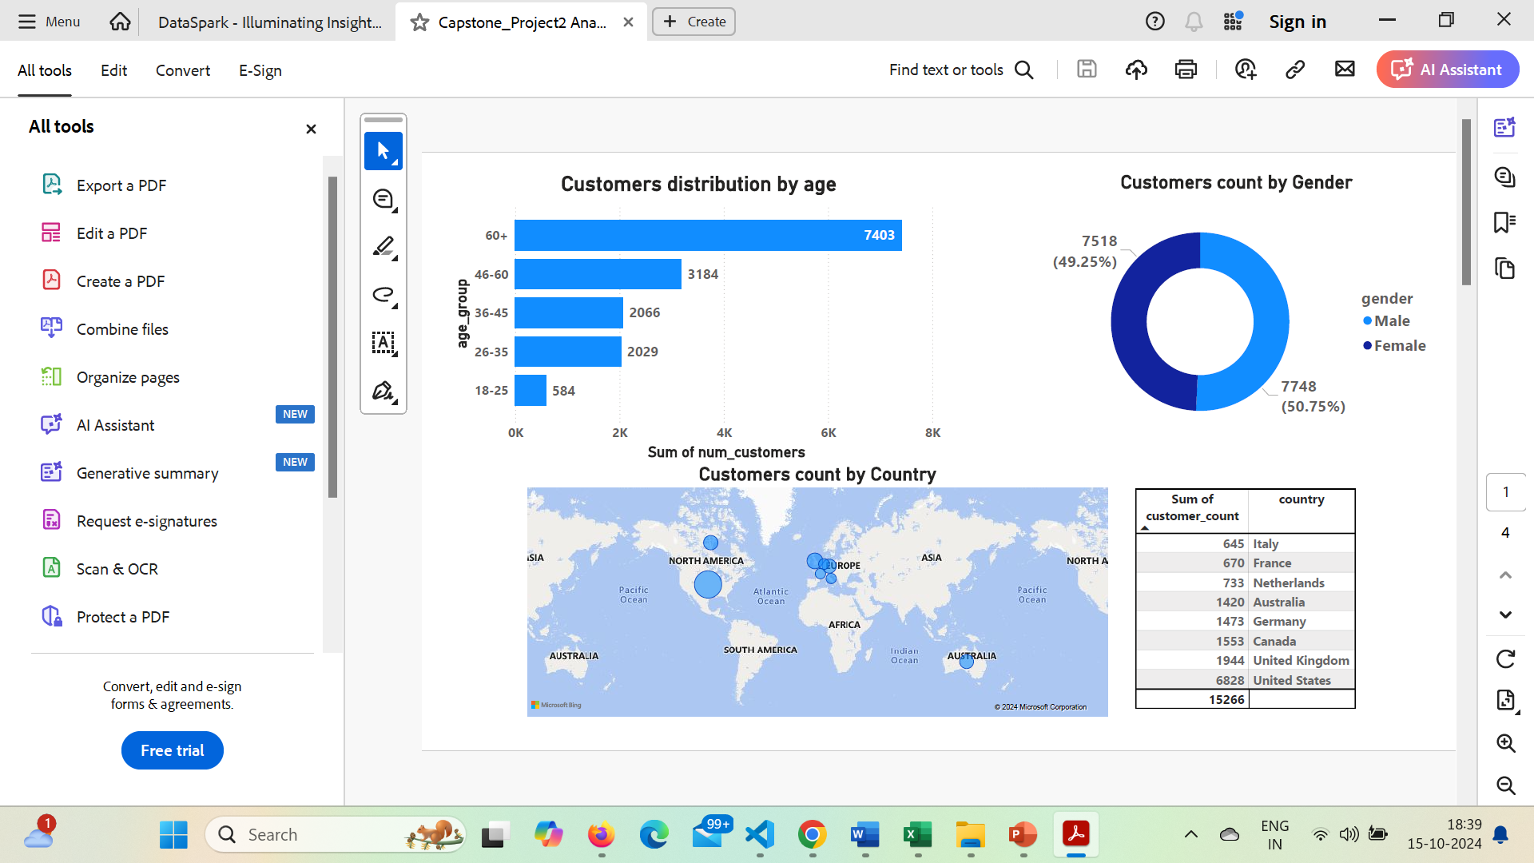
Customer Analysis
Gender Distribution:
Customers count based on Genders distribution is analysed
As compared to female customers, male customers are dominating in numbers
Age Analysis:
Using bar chart, visualization of customers are bucketed based on their age
When compared to other age groups, above 65 years are higher in counts

Slide 8

Results: Customer Analysis
Customers Distribution by Country:
The global map was used to illustrate the location-wise analysis.
The bubble's size indicates how strong sales are in that region.
According to the country-by-country investigation, sales are highest in North America.

Slide 9
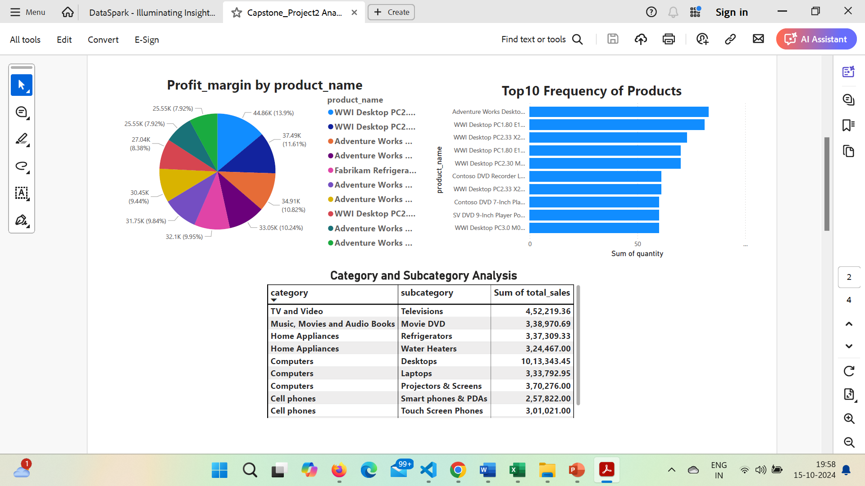
Results: Product Analysis
Profit margin by Product:
The Pie chart clearly visualize the top product based on the profit margin.
Among top 10 products, WWI Desktop computers are dominating in profit margin.
Top 10 Frequency Products:
The top selling products are from the Desktop and computer segment.
It’s highly recommended to keep sufficient inventory to meet the customer demand.

Slide 10
Results: Product Analysis
Product Analysis by Product Category:
Among several category of products, sub category of desktop (computers category) attains higher number of sales

Slide 11
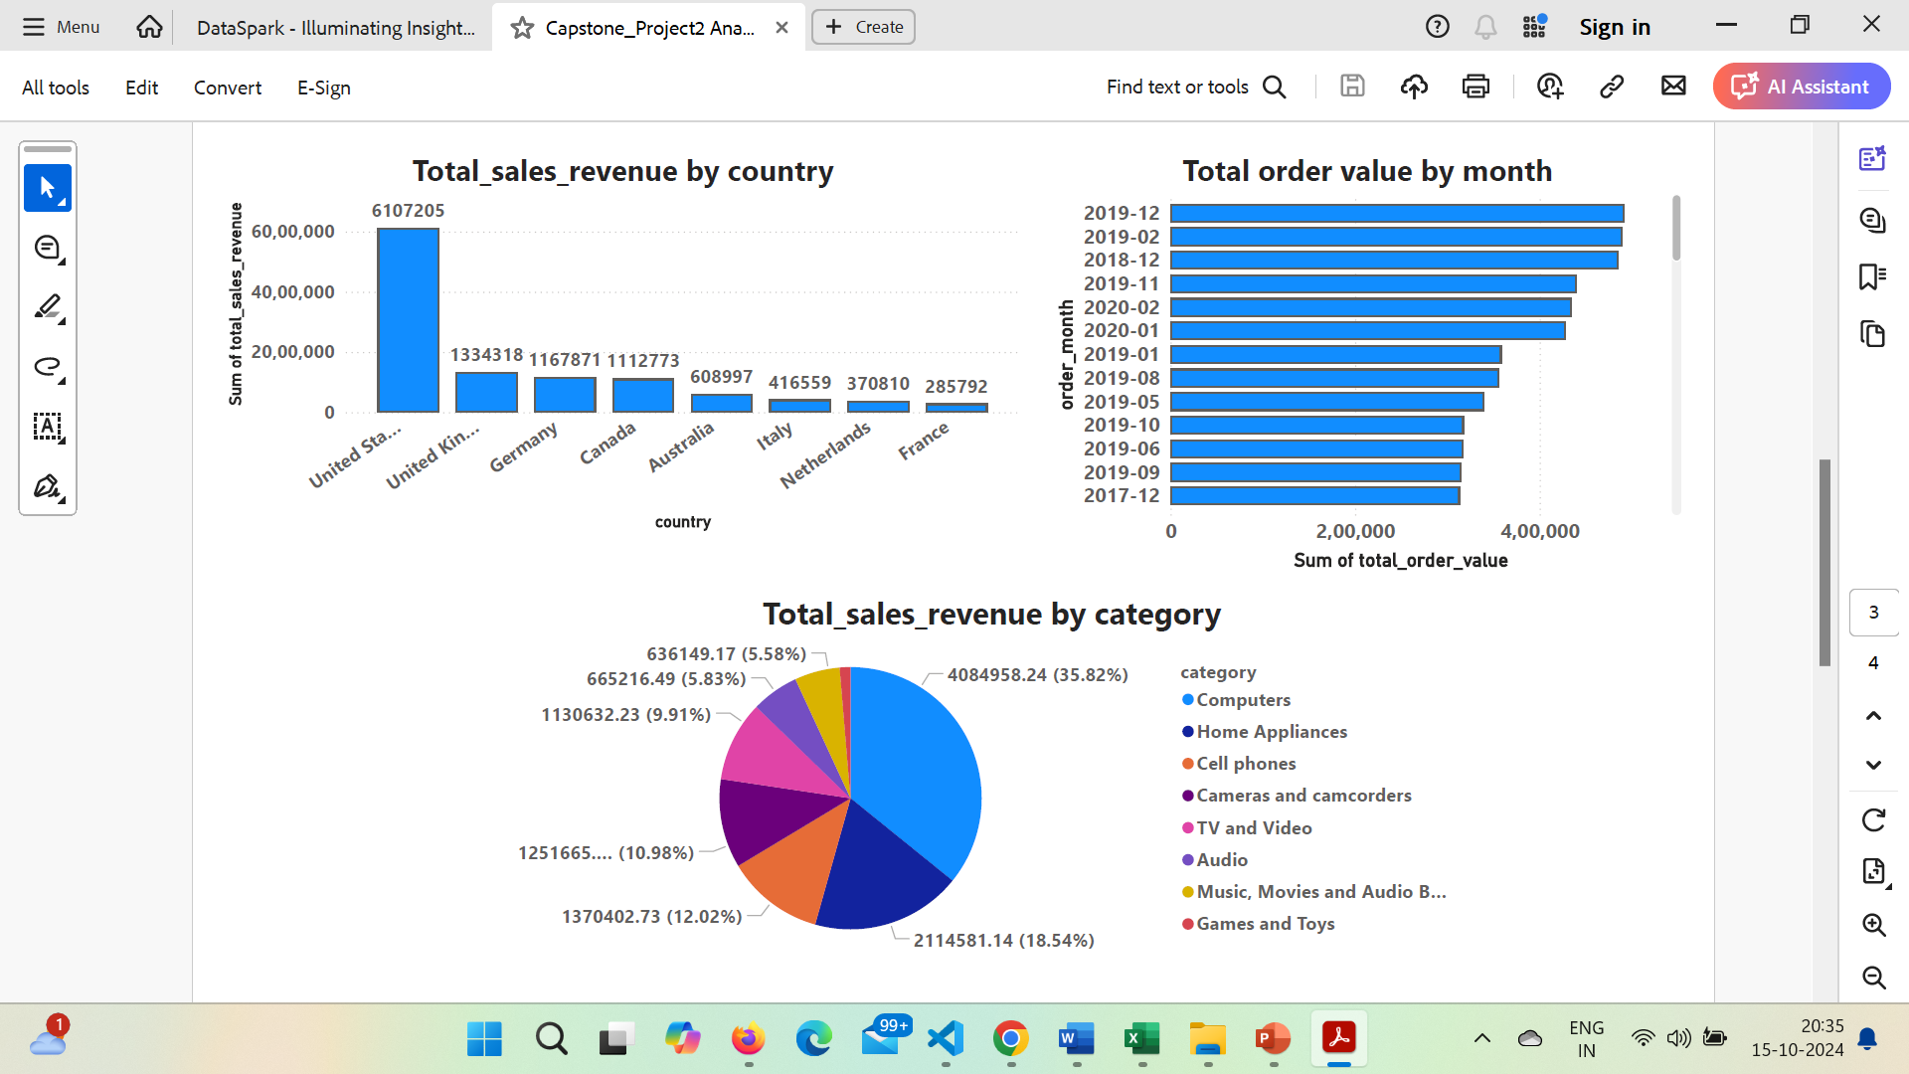
Results: Sales Analysis
Total sales revenue by country:
Among other countries, United States attains highest sales revenue
Total sales revenue by category:
Computers category gives highest sales revenue than other products
Total order value by month:
Total order values are higher during the month of December and February in year 2019

Slide 12
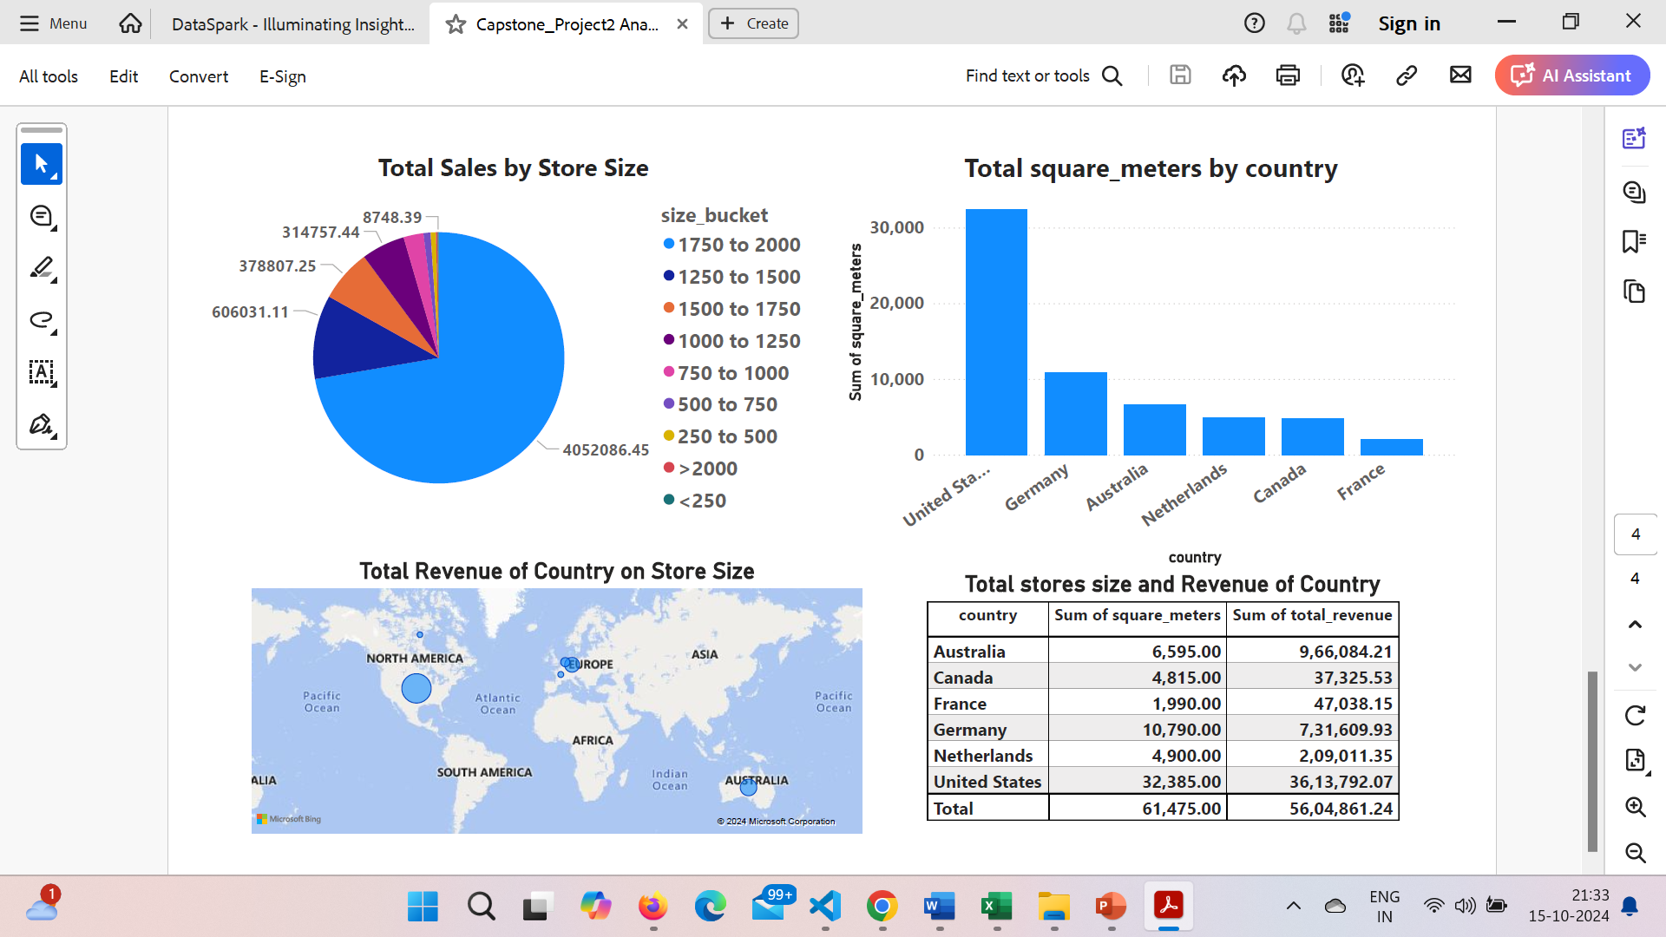
Results: Store Analysis
Total sales by store size:
The bucket size of store area 1750 to 2000 sq.mts. attains highest sales (more than 50 % of entire sales).
Total size of Store by Country:
As per bar chart, total size of stores (sum of store sizes) are high with United States (36,13,792 sq.mts.)
Total Revenue by store size:
In Global map, North America having the highest sales revenue (larger bubble size) than other countries,

Slide 13
Thank You

